Slide 1





Reproducible National-level Reports:
Using R Markdown to Recode the Fisheries Economics of the United States Report
Emily Markowitz¹
Research Fisheries Biologist
Alaska Fisheries Science Center
National Marine Fisheries Service
National Oceanic and Atmospheric Administration
Seattle, WA
Before Sept. 28, 2020:
¹Contractor, ECS Federal in support of
NOAA Fisheries Office of Science and Technology
Economics & Social Analysis Division
Emily.Markowitz@noaa.gov
@EmilyHMarkowitz
@EmilyHMarkowitz
Notes:
Hi everyone! My name is Emily Markowitz and I am so excited to share this work with you today.
So as you can see from my title slide, I recently changed positions. I am now a federal employee working at the Alaska fisheries science Center in Seattle Washington, but that was only as of Monday this week. Before that I was the main editor of the fisheries economics of the US report. “editor” it’s a little broad here, as I did a lot more than that.
I should also mention here that I am neither in economist nor social scientist – my background is actually in quantitative fisheries ecology. This role has been occupied by people from a variety different backgrounds, all contributing something important to the report that didn’t have before. There have been true word by word editors, there have been economists, but what the report really needed this round with someone who could automate it. And that is where I came in.

Slide 2



Fisheries Economics of the US (FEUS) Report
NOAA Fisheries produces the annual Fisheries Economics of the United States (FEUS) report
Describes how U.S. fishing affects the economy, in terms of employment, sales, and value-added impacts
Notes:
Fisheries Economics of the United States (FEUS) report is one of the two high level reports that my previous office (The office of science and technology) produces. This is not to be confused with the Fisheries of the US report, which are *supposed* to be lagged one year behind from each other.
Where FUS discusses the catch in terms of cost and pounds, FEUS goes one step beyond that --
FEUS describes how U.S. fishing affects the economy, in terms of employment, sales, income, and value added impacts.
Employment impacts describe how many captains, crew, processors, wholesalers, importers, restauranters, and grocers there are.
Sales describes how much those fish are worth at each stage from harvesters to retail.
And value-added impacts describe how that money transfers support employee families and the services they purchase.

Slide 3
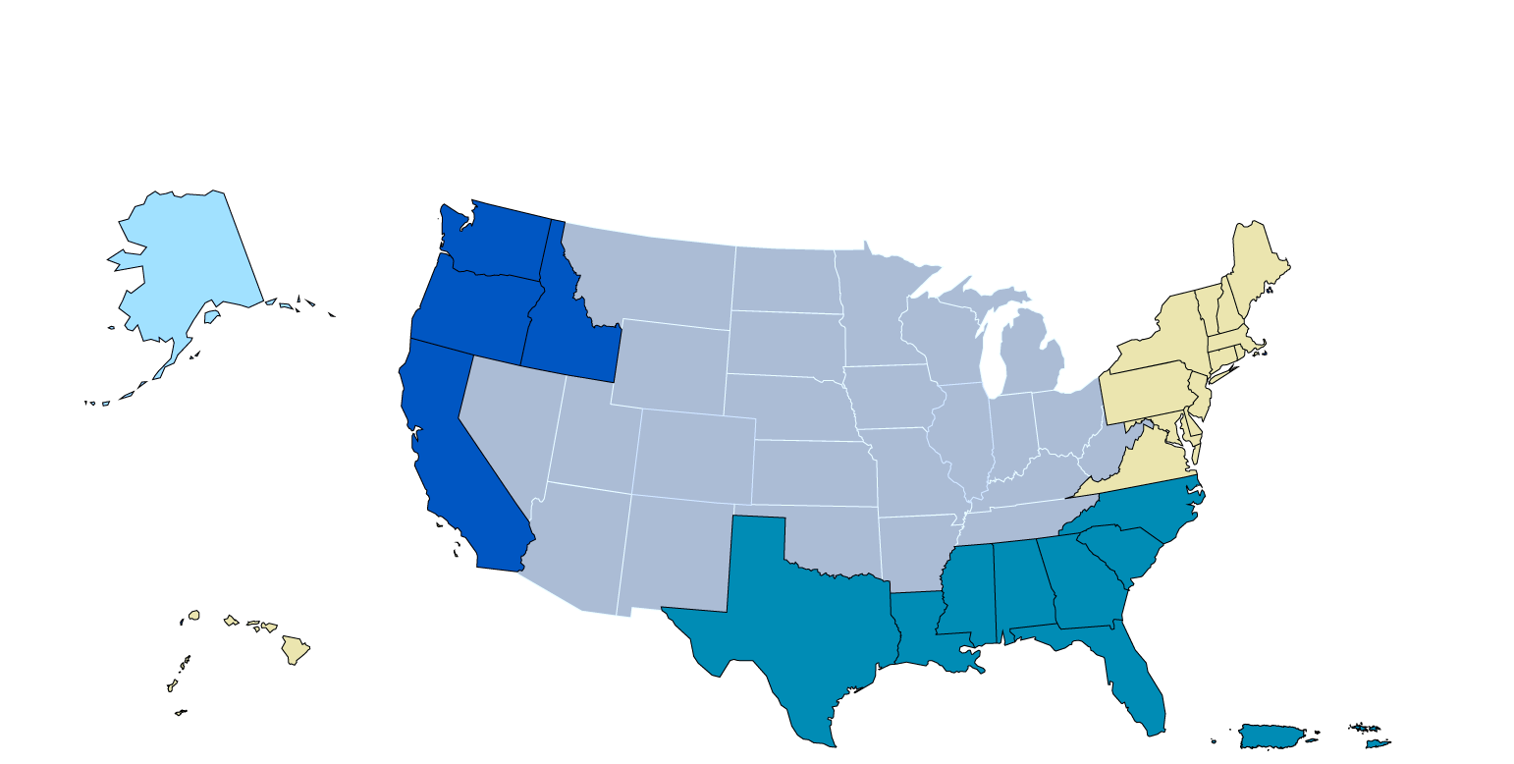
National, Regional, and State-Level Summaries
North Pacific
Pacific
New England
Mid-Atlantic
West Pacific
South Atlantic
Gulf of Mexico
Notes:
FEUS includes National, Coastal Regional, and Coastal State-Level Summaries. The 7 regions include …. And their collective 23 states are highlighted on the map above.

Slide 4
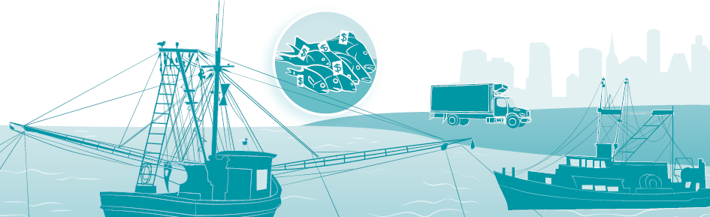


10 Years of Economic Performance Data
Commercial
Recreational
Marine
Economy
landings, revenue, price trends
effort, participation rates, expenditure information
employer and non-employer establishment, payroll, annual receipt information for fishing-related industries
Notes:
For each area, we provide 10 years of economic performance data for the commercial, recreational, and marine economy industries.
The Commercial section uses landings, revenue, price, and economic impacts data.
The Recreational section effort, participation rates, expenditure information
And the Marine Economy provides context on employer and non-employer establishment, payroll, annual receipt information for fishing-related industries

Slide 5
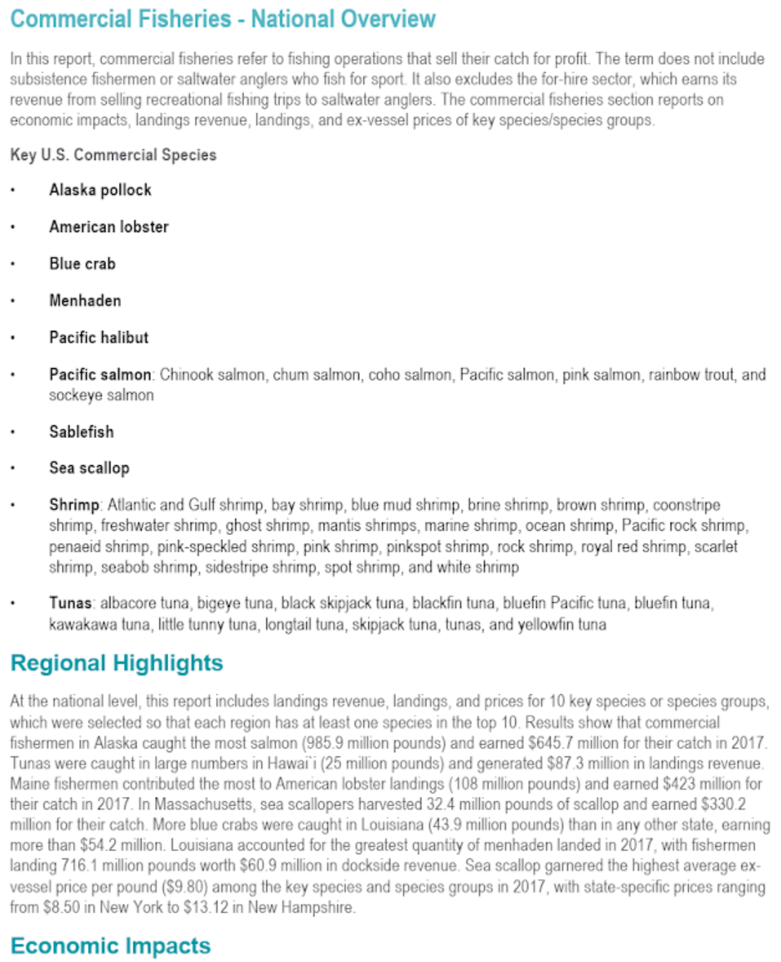
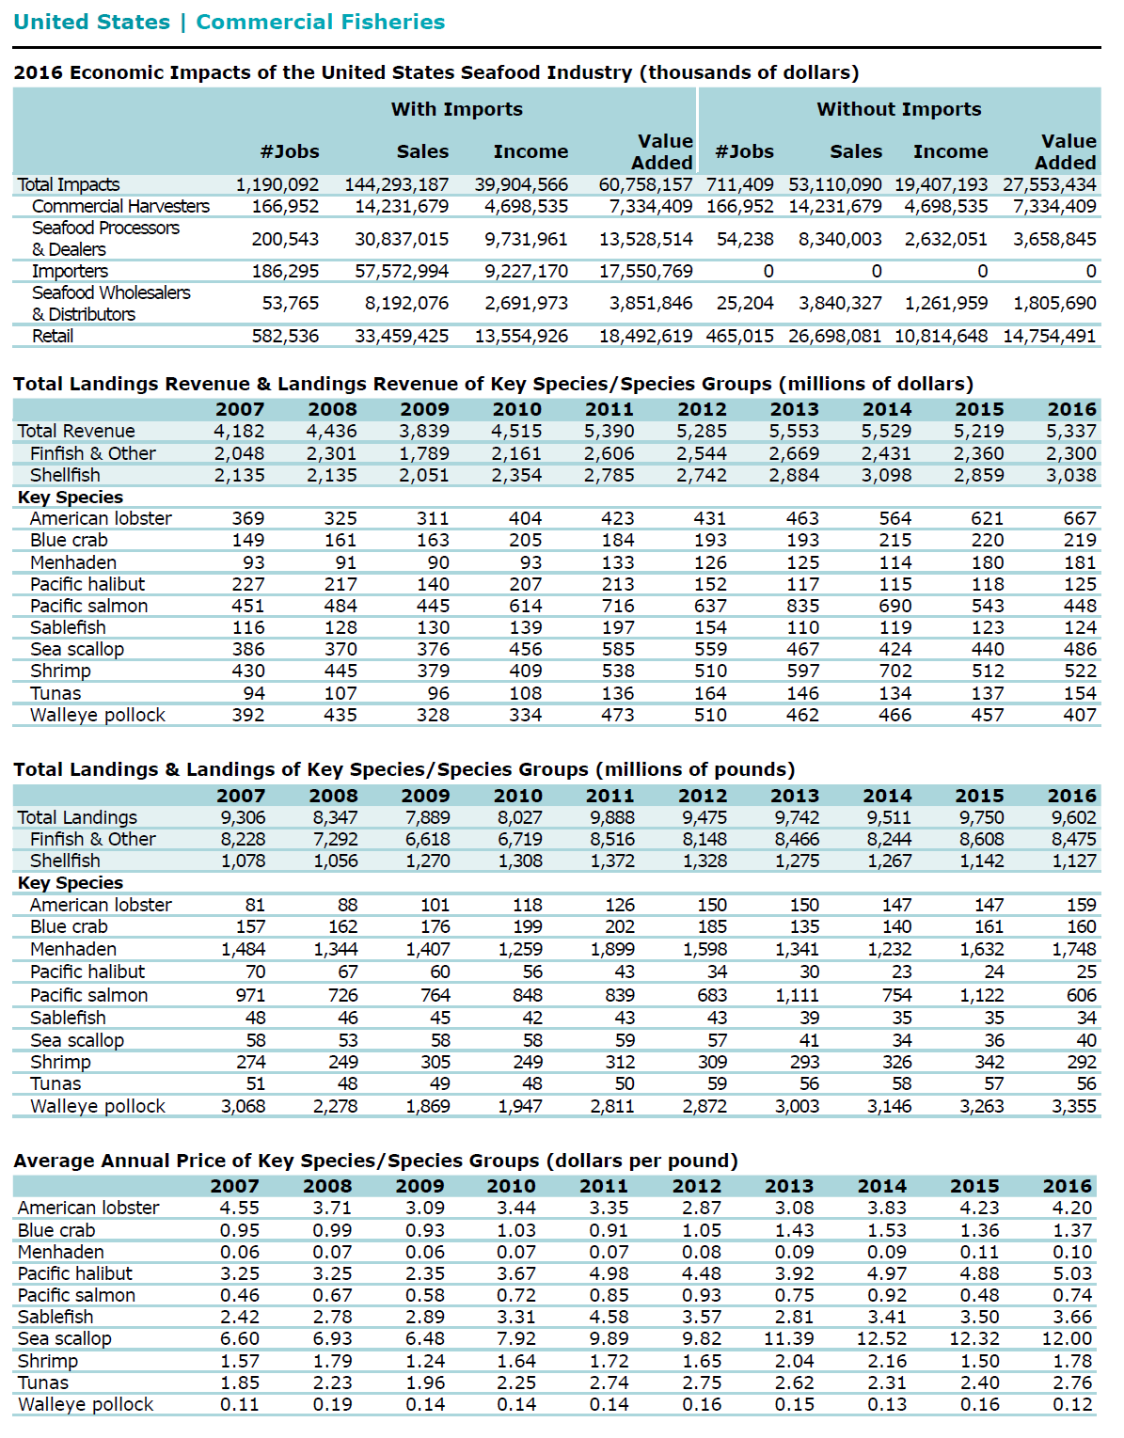




$$= \left[\begin{matrix} & \\ & \begin{aligned} \\ \\ \\ \\ \\ \\ \\ \\ \\ \\ \\ \\ \end{aligned}\end{matrix}\right]×\left[\begin{matrix} & \\ & \begin{aligned} \\ \\ \\ \\ \\ \\ \\ \\ \\ \\ \\ \\ \end{aligned}\end{matrix}\right]×\left[\begin{matrix} & \\ & \begin{aligned} \\ \\ \\ \\ \\ \\ \\ \\ \\ \\ \\ \\ \end{aligned}\end{matrix}\right]$$
3
Impacts
Direct
Indirect
Induced
31
Areas
(US, Regions,
and States)
3
Sections
4-5
Tables +
1 Regional Text
Commercial
Recreational
Maine Economy
10
Species
Groups
~ 511‬ Separate Key Report Elements
Notes:
As you can imagine, this adds up.
Between 31 areas, 3 sections, and 5 or so elements (really, a crude over simplification) that need to be created for each section, we are talking about 511 separate key report elements that go into the report. This doesn’t even mention all of the mid-step products that need to come out of this code

Slide 6


How a Report Gets Created
Previously:
Collating and preparing the report from all the provided (or not provided) pieces.
Collect Data
SMEs Determine Data Caveats
Report Editor Prepares Report
SMEs Review Report Content
Leadership Reviews and Approves Report
Report is “Rolled Out” for Public Release
Design Report, Infographics, and Fact Sheets
Series Editor Signs Off on Report
Designer makes Report 508 Compliant
Collect Data
Now:
Cover or support these parts of the report creation process.
Notes:
But ‘what goes into the report’ is really just one step of the process.
As a nationally important report, there are a lot of people who get involved in different stages of the process.
First, subject matter experts (or SMEs for short) collect data, …
[click] Previously, it was the job of the person in my position to just focus on this one part of the process – preparing the report from all of the provided (or not provided) parts.
[click]However, updating the report as I am going to show you in the next few slides, it is actually possible for that one report editor to control or majorly contribute to these parts.

Slide 7


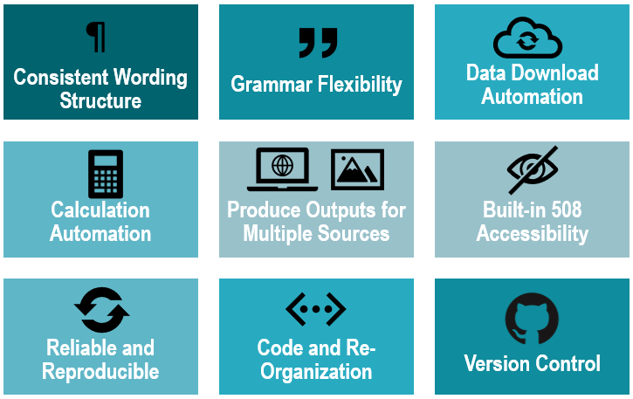

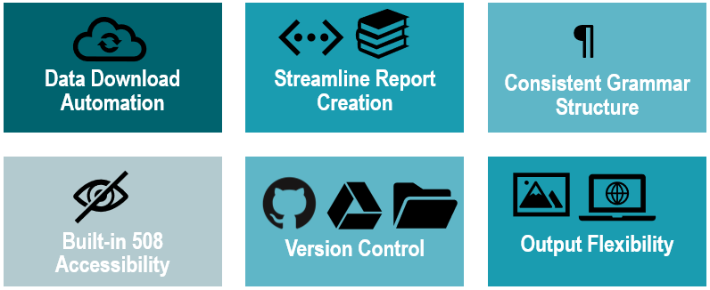















Requirements to Automate a Large Report:
Built-in 508 Accessibility
Version Control
Consistent Grammar Structure
Streamline Report Creation
Output Flexibility
Data Download Automation
¶
Notes:
To really improve the report creation process for the long term and in terms of reproducibility, I had my work cut out for me. If I had to name the main culprits we had to focus on, I would call out: ….

Slide 8


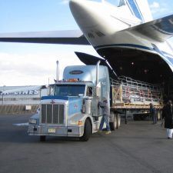
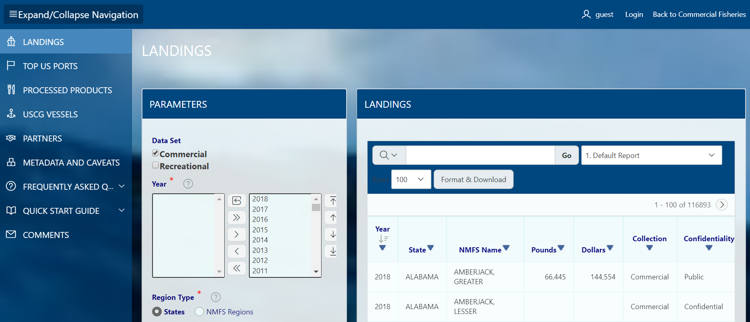
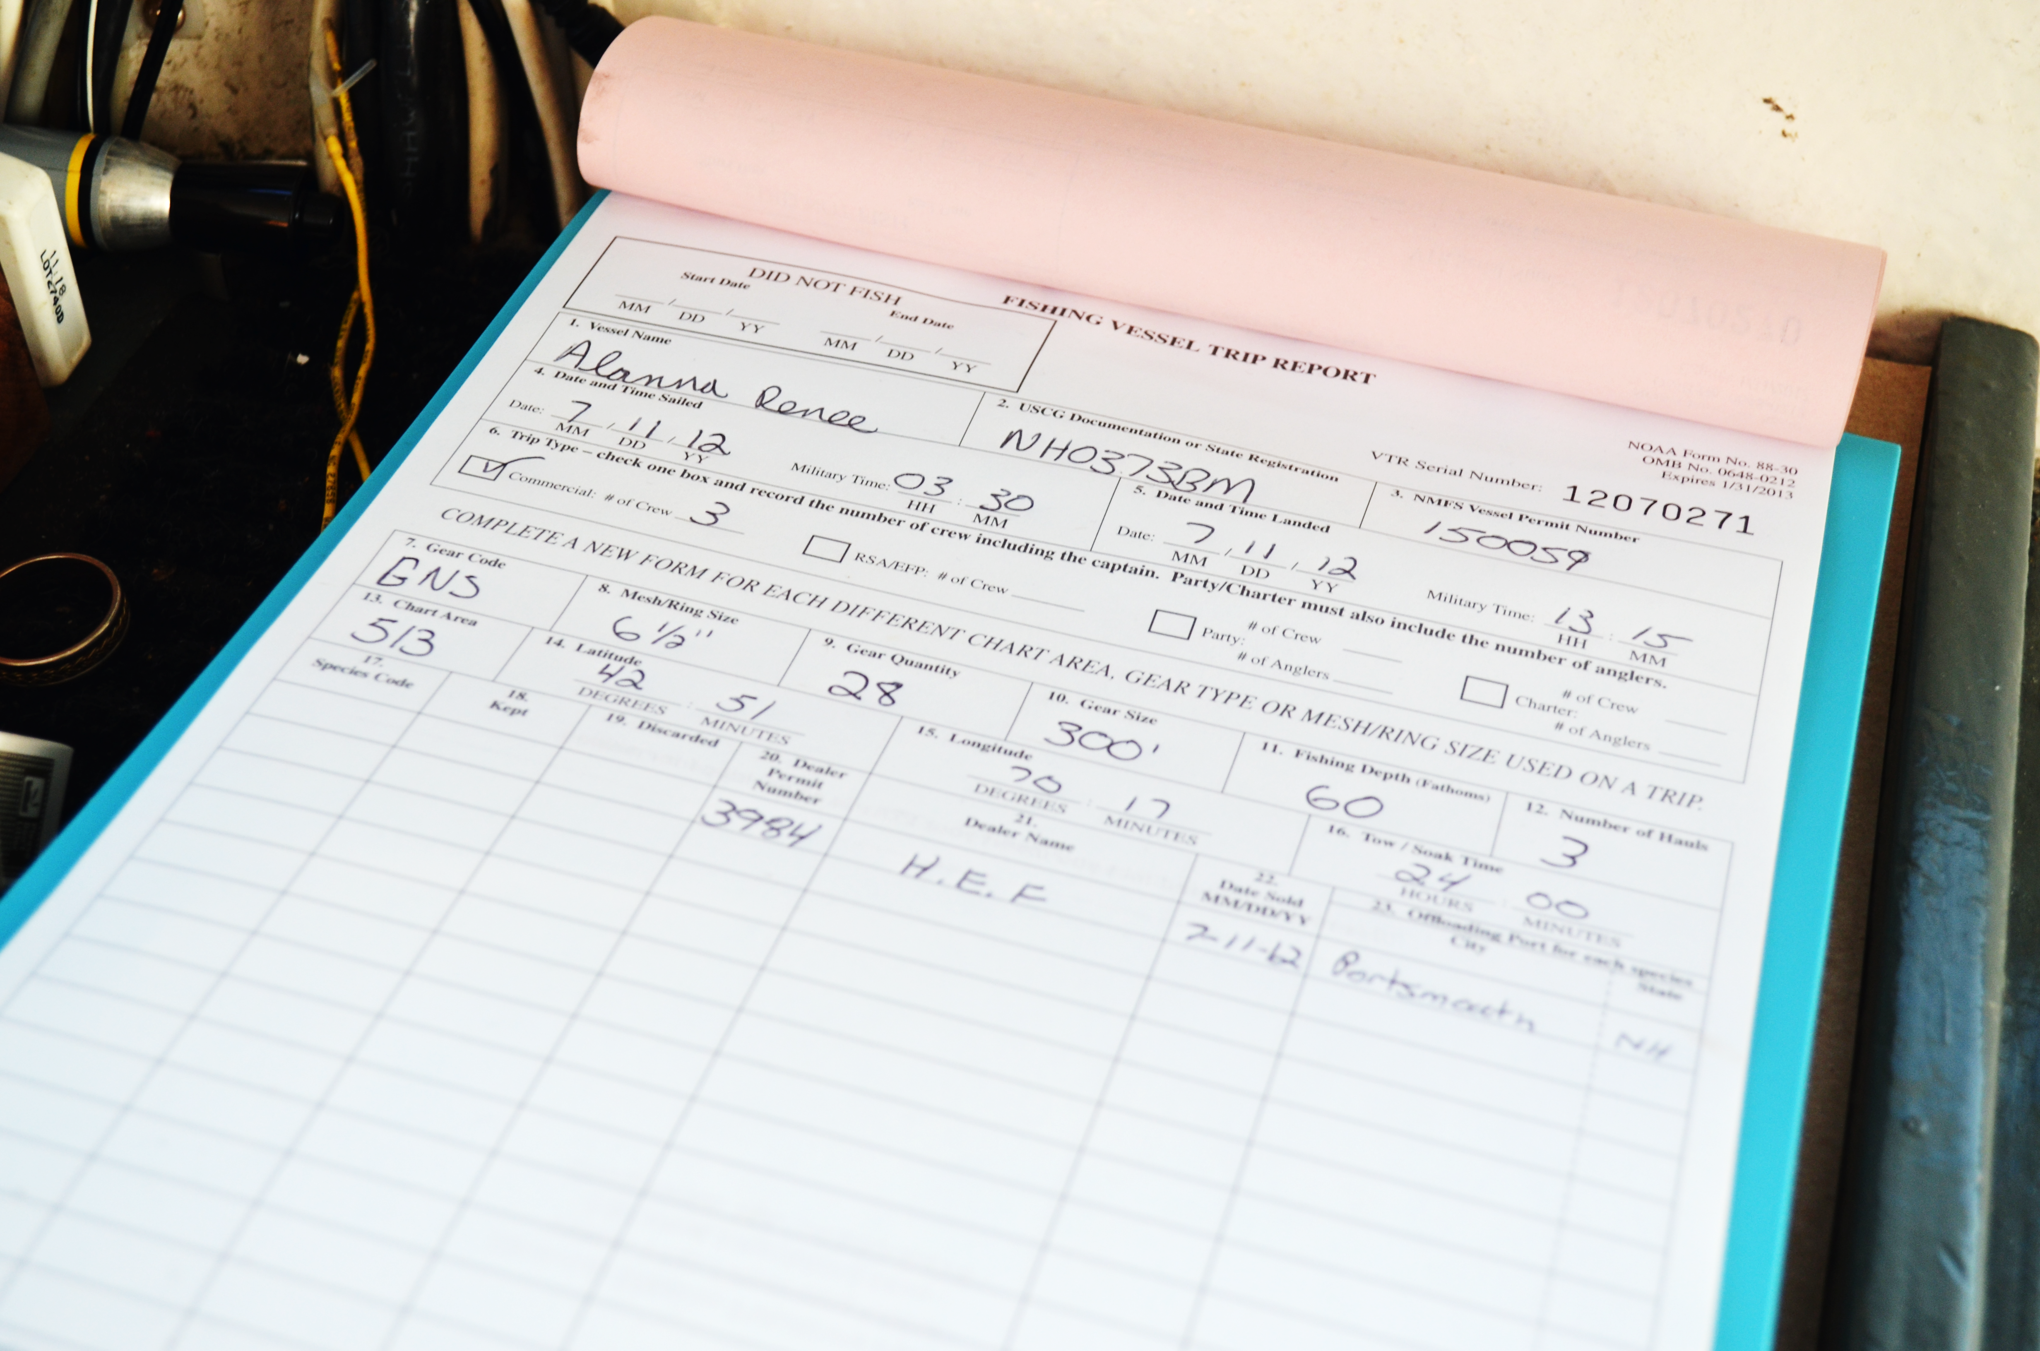

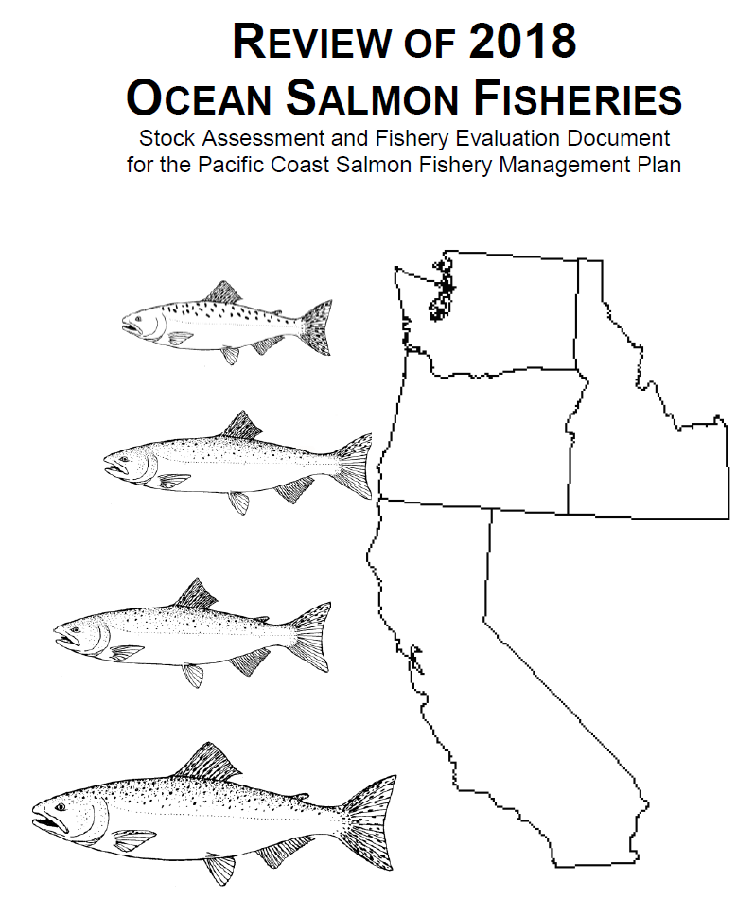

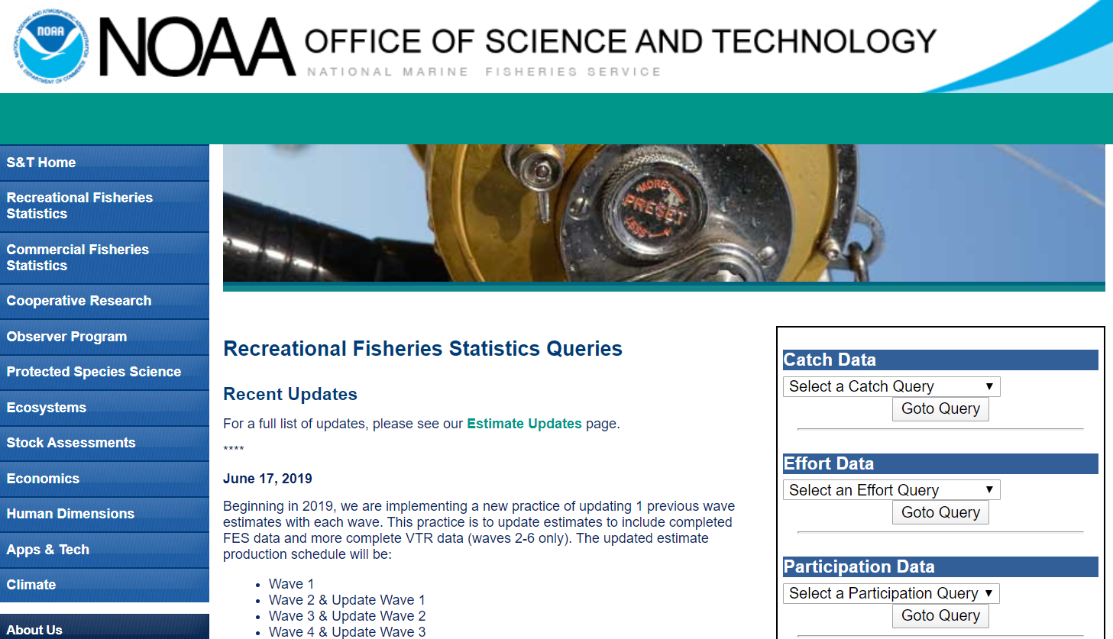
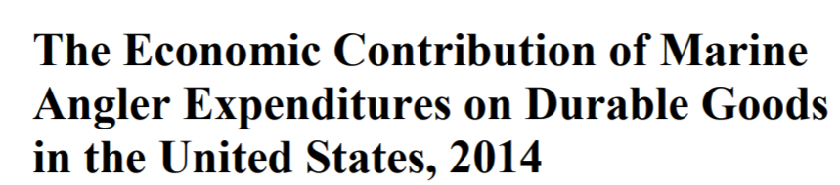



Commercial
Recreational
Marine Economy
State and Local Data
Notes:
First offender would absolutely be access to the raw data. Previously the report editor would have the data managers in the office and across the regions put together the data that we needed for the report. No quams with my predecessor (they were not a data person), but it contributed to massive delays in even starting the report.
[click]
While it took a while to convince people to hand over data access to me (delegating tasks away from contributors can be a sore point in any situation) I now have direct access to many of the national and regional datasets that go into the report.

Slide 9



Previously for a Typical Section…
R Markdown
All Reg Sections.RMD
###National
```{r}
US.data$jobs<- 8000000/1000
```
In 2015, the U.S. had a `r US.data$jobs ` thousand job increase (see figure 3).
###North Pacific
```{r}
AK.data$jobs<- 9000/1000
```
In 2015, the North Pacific Region had a
`r AK.data$jobs ` thousand job increase; figure 4.
R Markdown
R Scripts
[Missing Resource]
Section_
AK_HI
.RMD
Section_
text
.RMD
Download from Data Source 1 .R
Load Data Saved on Local Drive 2
.R
Edit Data.R
Download and Edit Data
Section_
REGIONS
.RMD
State Tables
.RMD
[Missing]
Tables 2.R
Tables 3.R
Tables 1.R
[Missing]
Tables 4.R
[Missing]
Section.docx
Produce Tables
National
In 2015, the U.S. had a 8000 thousand jobs increase (see figure 3).
North Pacific
In 2015, the North Pacific Region had a 9 thousand job increase; figure 4.
[Other Missing
Content]
Missing data
Notes:
When I first started, there were some r scripts and markdown files that had already created for each section.
Several years before my time, someone had tried to completely automate the report, but (possibly) to limited avail.
[click]
Unfortunately, many of those files were missing or simply never created. The files were poorly named, had shared tasks, and often extremely incomplete or occasionally incorrect. I know my processor had to do a lot of line-by-line editing – the scripts were helpful but often untrustworthy.

Slide 10

Updated Section
R Scripts
{}
R Markdown
Run.R
Common
#Load Data and Functions, Create Tables and Content
#Output Report Sections .docx
##National ##Regional
Data.R
Functions
.R
Produce Section-Specific Tables
Common Functions
.R
Edit Text and Tables
All Reg Sections.RMD
###National
```{r}
US.data$jobs<- 8000000/1000
```
In 2015, the U.S. had a `r US.data$jobs ` thousand job increase (see figure 3).
###North Pacific
```{r}
AK.data$jobs<- 9000/1000
```
In 2015, the North Pacific Region had a
`r AK.data$jobs ` thousand job increase; figure 4.
Section
Incorrect Units.
For Each Region
For Each State
National
.RMD
Poor Grammar
Run
.R
Region
.RMD
Inconsistency
State Tables
.RMD
Section.docx
Hard-coded year, region, separate data sets.
All regional and state table sections are run through the same R Markdown files
National
In 2015, the U.S. had a 8000 thousand jobs increase (see figure 3).
North Pacific
In 2015, the North Pacific Region had a 9 thousand job increase; figure 4.
Notes:
A lot has changed since then. Now each section lives in an R Project and is run by what I call a “Run” file –
[Click] this Run file is an r script that controls the production of each section.
[Click] First the Run file pulls a common functions script that is applied to all sections of the report. This common functions file is drawn from the “Common” R Project.
[Click] Then the script loads (or downloads) the data via the Data.R file and loads section-specific functions in the “Functions.R” script
[Click] Then we start writing the sections. National has some specific elements so it is run uniquely, but…
[Click] because the region and state subsections are so formulaic, the script simply loops through these files with the relevant data.
This strict and uniform process for each section will help collaborators and those after me to follow with my workflow and make it easier to understand where things could have gone wrong and with reproducing this process for years to come.

Slide 11
Previously for a Typical Section…
Incorrect Units and Poor Grammar
Poor Grammar
Incomplete Sections
R Markdown
Word Documents
Section.RMD
Section.docx
#National
In 2020, the U.S. had `r US.data$jobs[US.data$Yr = 2020]/1000 ` thousand jobs, equaling a `r US.data$jobs[US.data$Yr = 2020]/US.data$jobs[US.data$Yr = 2010]*100 ` % decrease (see figure 3).
#North Pacific
In 2020, the North Pacific Region had `r AK.data$jobs[AK.data$Yr = 2020]/1000 ` thousand jobs; table 1.
…
#Pacific
…
National
In 2020, the U.S. had 8000 thousand jobs, equaling a 8% decrease (see figure 1).
North Pacific
In 2020, the North Pacific Region had 9 thousand jobs; table 4.
incorrect units
Redundant Code
Hard-coded region-specific data sets and names.
Inconsistency
Doesn’t Print Tables or Figures in Text
Notes:
Previously for a typical section,
[Click] Rmarkdown files (those that existed anyway) would include most sections in one file and would be unorganized and incompete – missing text, figures, and tables
[Click] The code would duplicate code from one section to another but just change the name of the file it required
[Click] and hard code the year, region, and other year-to-year changing variables
[Click] and would not dynamically correct or incorrect units and poor grammar –
“8,000 thousand” should be “8 Million” and
“8%” should be proceeded by an “an” not an “a”

Slide 12
Updated Section
Incorrect Units and poor grammar
Auto-Correct Units and Grammar
Complete
Sections
R Markdown
Word Documents
Consistency!
#National
In `r yr`, the U.S. had `r unitx(land.data$reg[region])` pounds (Figure 1).
### Figure 1. `r Figures[region]$F1.Title `
```{r}
Figures$US$F1.Plot
```
In `r yr`, the U.S. had `r unitx(jobs.data$reg[region])` jobs, equaling pctx(jobs.data$reg[region]) (Table 1).
### Figure 1. `r Tables[region]$T1.Title `
```{r}
Tables[region]$T1.Table
```
National
In 2020, the U.S. landed 10 billion pounds of fish (Figure 1).
Figure 1. 2010-2020 U.S. Landings
In 2020, the U.S. had 8 million jobs, equaling
an 8% increase (Table 1).
Figure 1. 2020 Economic Impacts in the U.S.
National.docx
National.RMD
Copy-Edit Ready Figures and Tables Included
All regional and state table sections are run through the same R Markdown files
# `r Region `
In `r yr`, the `r region had `r unitx(jobs.data$reg[region])` jobs, equaling pctx(jobs.data$reg[region]).
NPacific.docx
North Pacific
In 2020, the North Pacific Region had a 9 thousand job, equaling a 9% increase.
Regional
.RMD
Now Print Tables or Figures in Text
# `r State `
`r Table1$Title[state] `
```{r}
Table1$Data[state] %>% knitr::kable()
```
Dynamic Data Inputs
Alaska
Table 1. 2020 Economic Impacts In Alaska
State Table
.RMD
Alaska
.docx
Notes:
The new code corrects for many of these issues
[Click] Firstly, these sections now complete ALL parts of the report – text, figures, and tables in the document
[Click] As show before, All regional and state table sections are run through the same R Markdown files
[Click] data is dynamically entered into each mark down file – year, region, and state change depending on the data that is provided when the script is run in the Run.R file
[Click] and finally,
functions like “unitx()” take the number and determine the appropriate unit for a value and
Functions like “pctx()” determine if a value has increased or decreased and if a “a” or “an” should proceed the percent number.

Slide 13

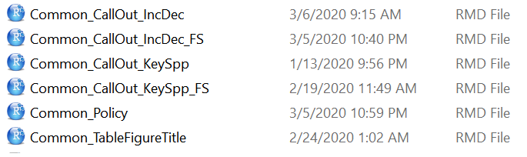





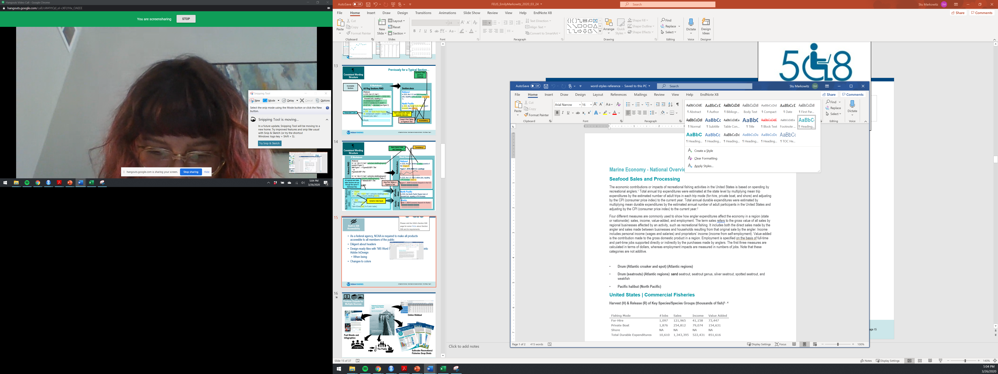

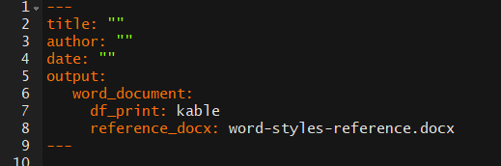
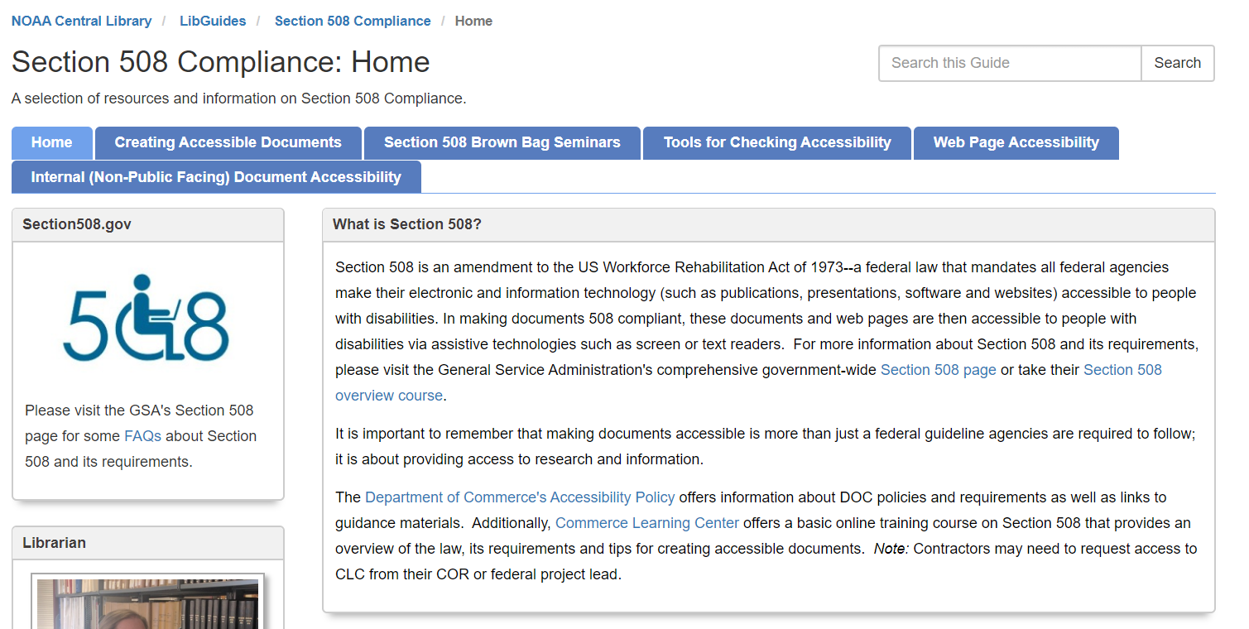
Common
amendment of the US Workforce Rehabilitation Act of 1973 mandates all federal agencies make their online products (websites, PDFs, etc.) accessible to people with disabilities.
For use by screen or text readers
https://libguides.library.noaa.gov/Section508/Home
Notes:
Section 508 is an amendment of the US Workforce Rehabilitation Act of 1973 mandates all federal agencies make their online products (websites, PDFs, etc.) accessible to people with disabilities. Anything that comes out of NOAA is no different.
The functional prupose is for any product to be searchable by screen or text readers.

Slide 14
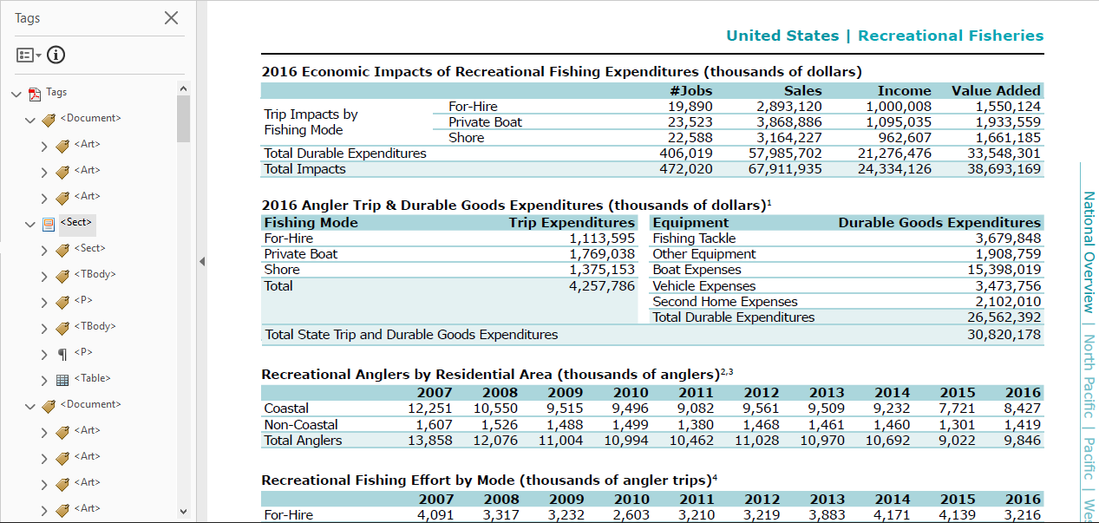
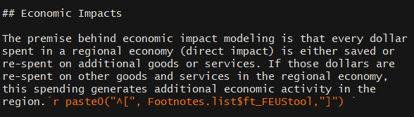
Common
Design-ready files to flow into Adobe InDesign
Formatting styles to tag sections (H1, H2, H3)
Webtool provides HTML version of report tables.
508-compliant colors and fonts.
H2 (Header 2)
P (Paragraph)
Footnote
Notes:
In R there are a few ways we can help our designers by making parts of the report 508 compliant.
Firstly we need to make these files readable and flow-able into Adobe InDesign with the appropriate tag sections (such as H1, etc)
As of this report, we will officially share an HTML/web version of the data in the report, allowing the impaired better access to playing with this data
And updating and improving the colors and fonts to be more disabled-friendly

Slide 15
Common
Notes:
You can also customize styles to match what you want your report to look like by adding a word style reference document into your YAML in your Rmarkdown file. This document is essentially a .DOCX file where you have defined what the headers should be.

Slide 16
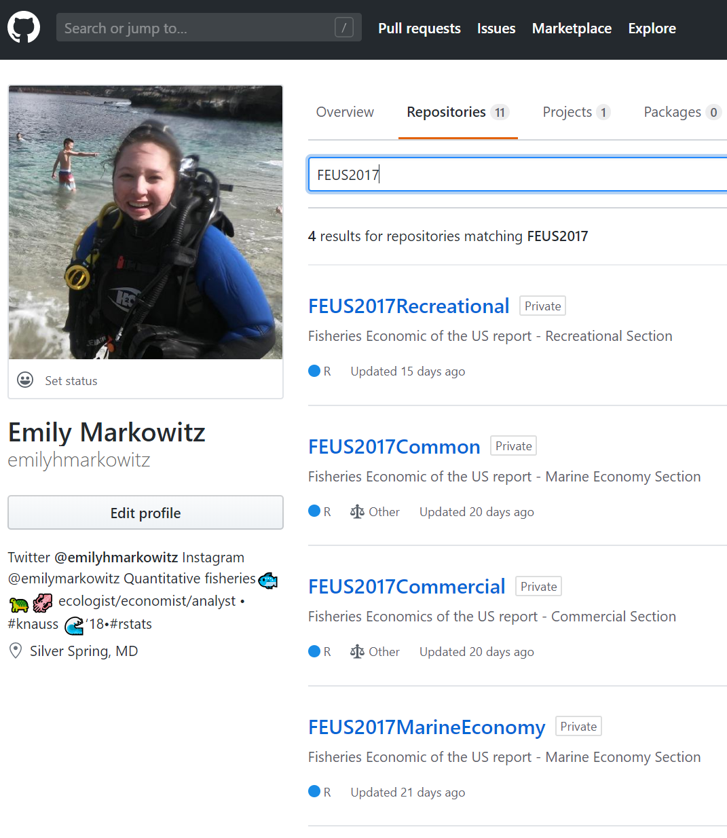

Recreational
Common
Commercial
Marine Economy
Notes:
Version control in this development process is crucial – not only am I updating so much about how this report is physically being created, but I am also changing and updating the content. To keep track of that, I created projects for each of the sections so I can annotate what changes I made to these section scripts as they come up.

Slide 17
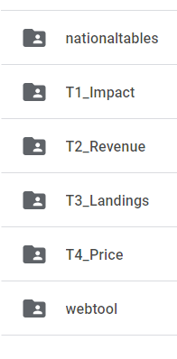

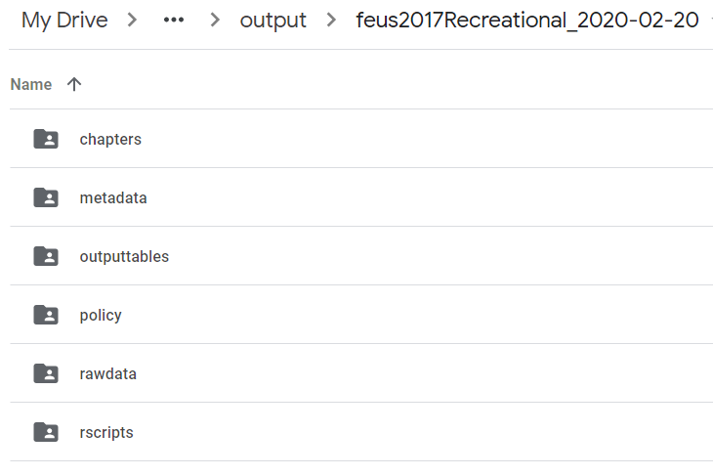
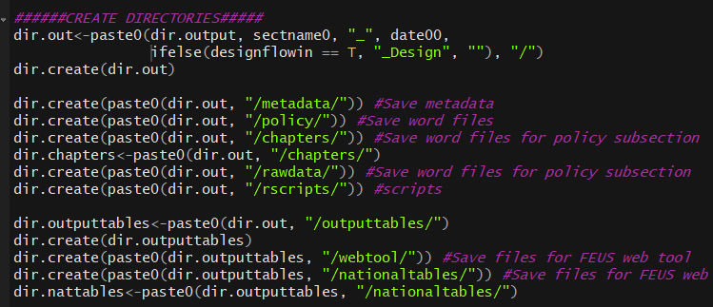
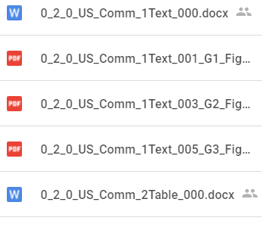
Run.R automatically creates file folders to save table, figure, and word document outputs in.
Runs also create a metadata file that documents which versions of R and packages were used.
Outputs shared on Google Drive for content review.
Each file is clearly labeled to match the appearance in the report and content of the file.
Notes:
For script outputs that need to be shared with my less tech savvy collegues, however, I have created a uniform file saving structure.
Every time the script is run, it creates a dated output file with uniform subfolders for chapters, outputtables, metadata, rawdata (for the data that went into the analysis), and rscripts that were used to create the analysis.
The metadata file documents when an analysis was run, what version of R it was run on, and what version of packages were used to run the files.
So my collegues can easily review the contents of these outputs from anywhere and comment on them collaboratively, I share that entire folder to google drive.
File naming is key here – so my collegues know what to look for from section to section, files are named for the order in which they appear in the report, and excplicitly named for the content of the file.

Slide 18
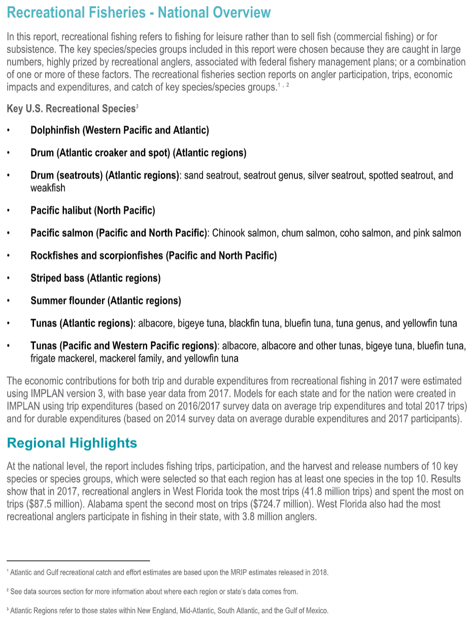
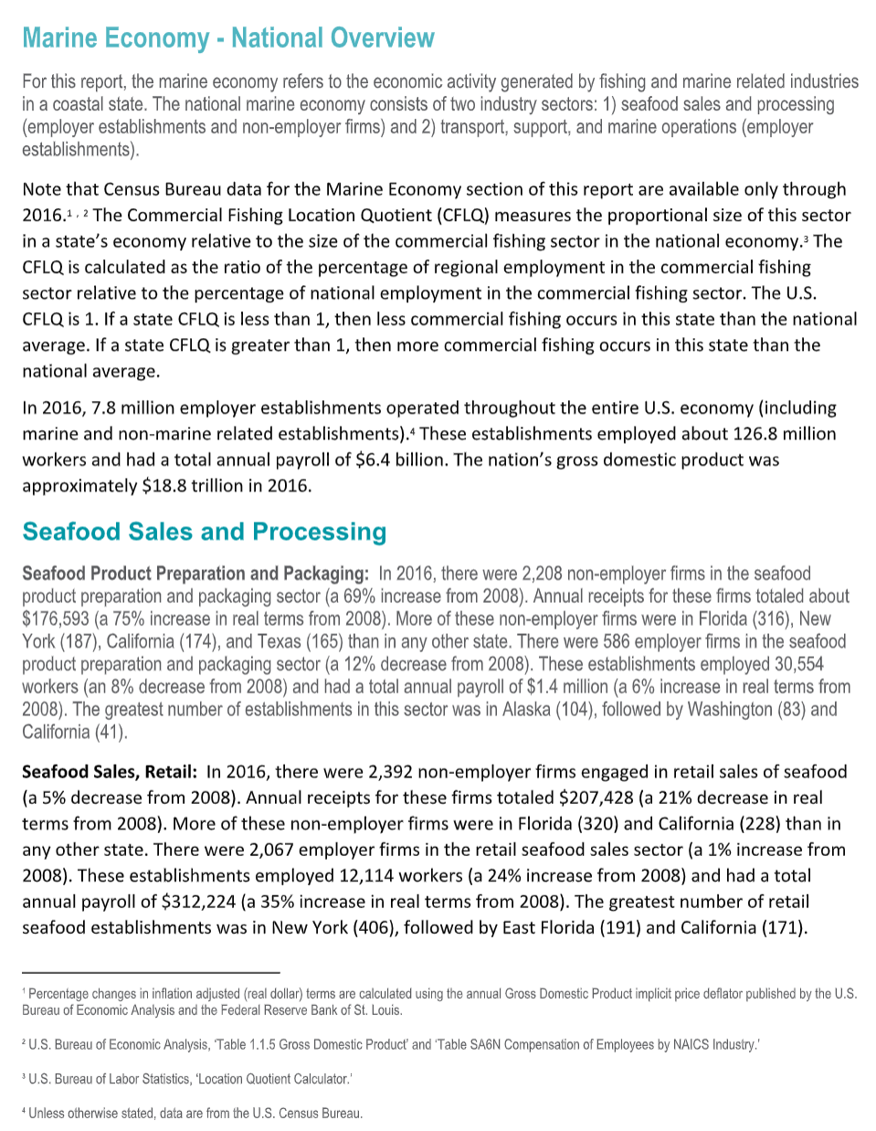
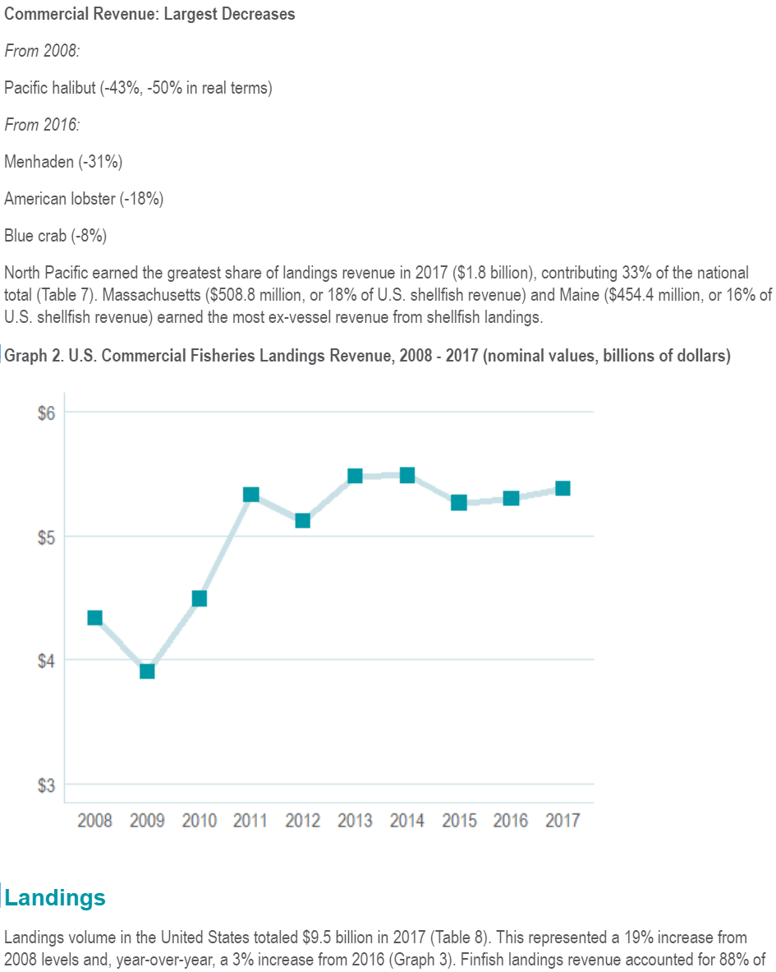
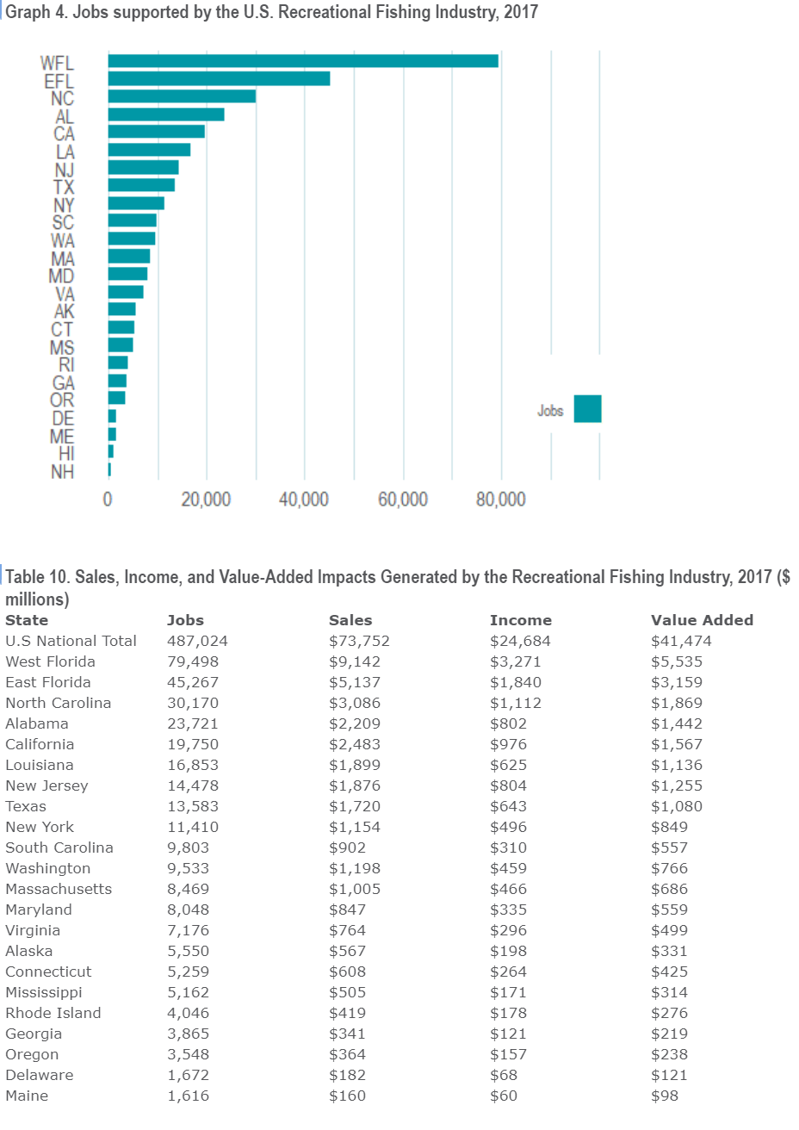
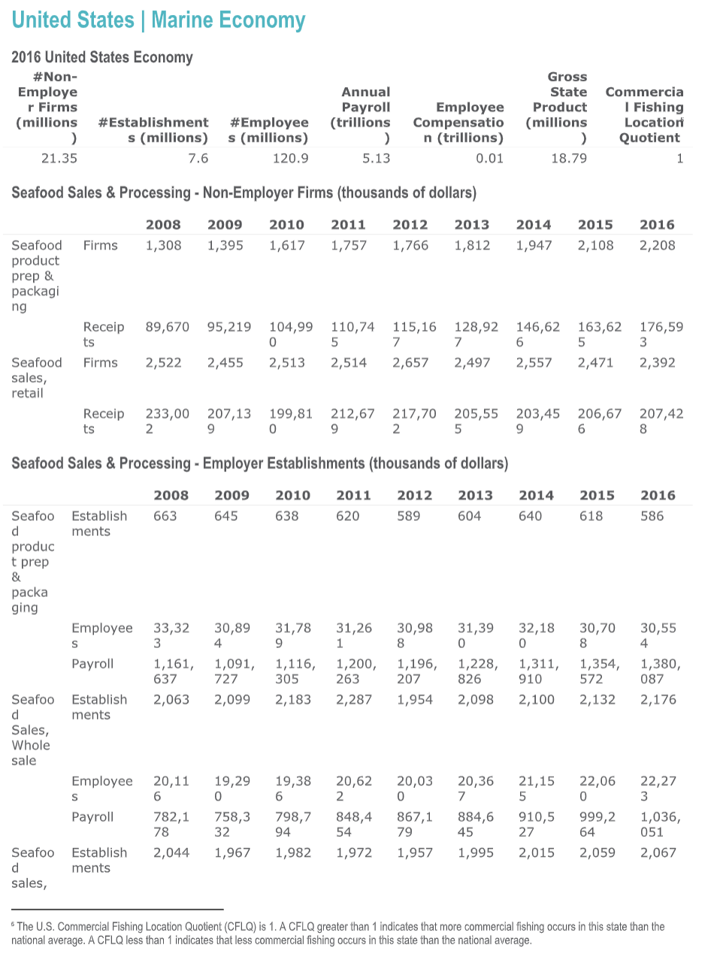
Common
Commercial
dd
Recreational
Marine Economy
Notes:
At the end of the day, these 4 R projects produce approximately 250 pages of content that go directly into the report. But in realitiy, the code does a lot more than that:

Slide 19

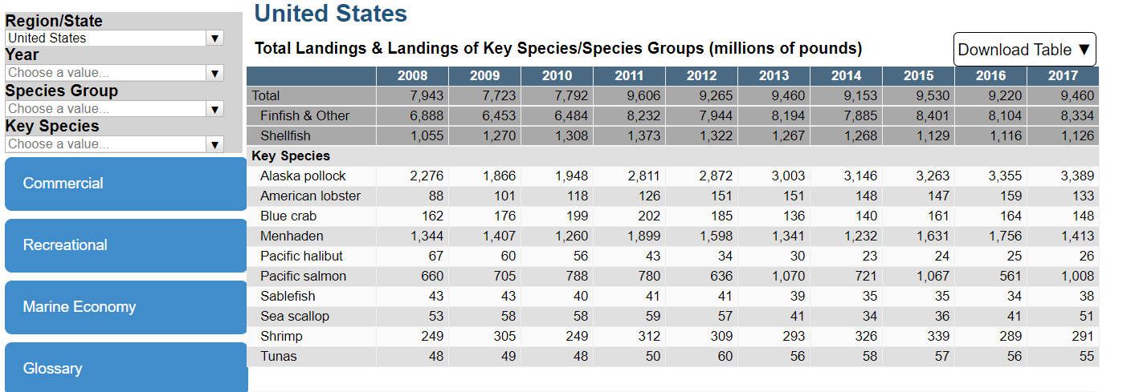







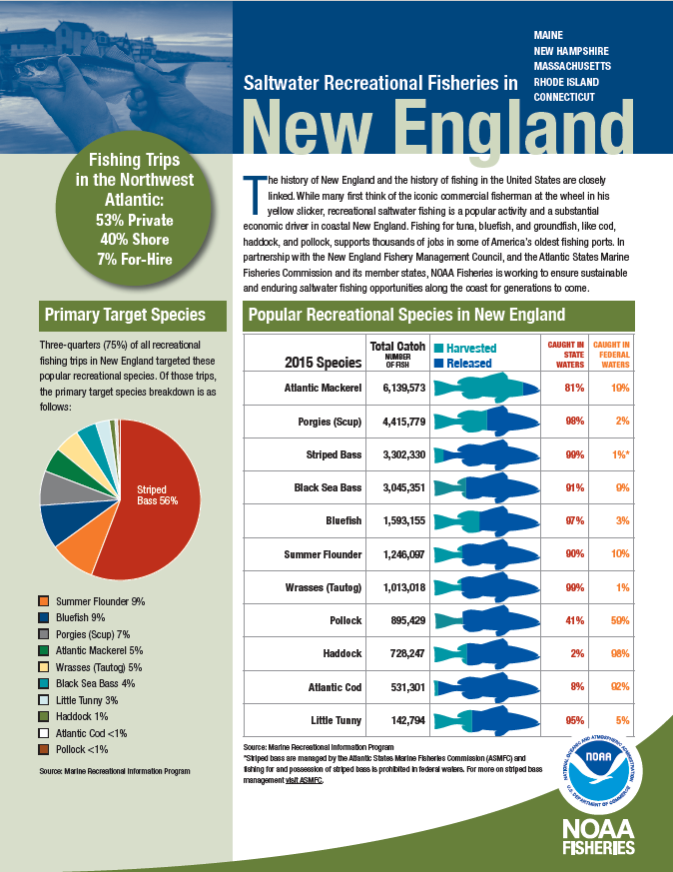
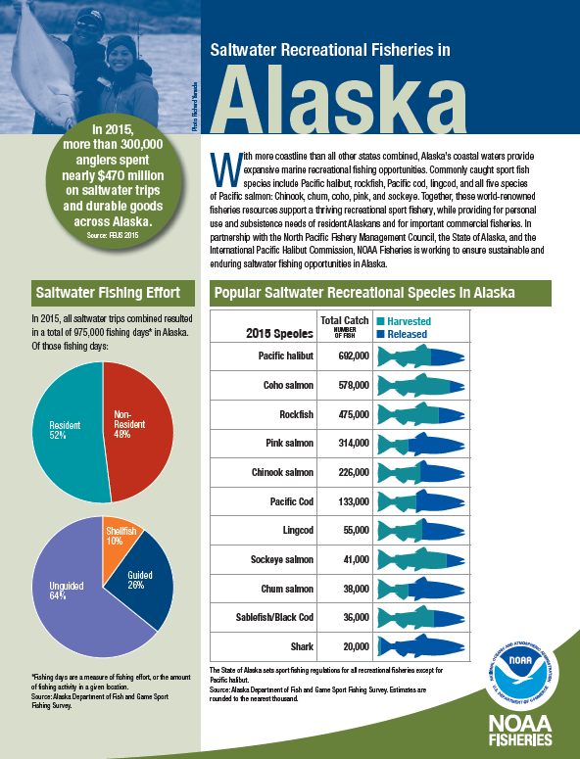
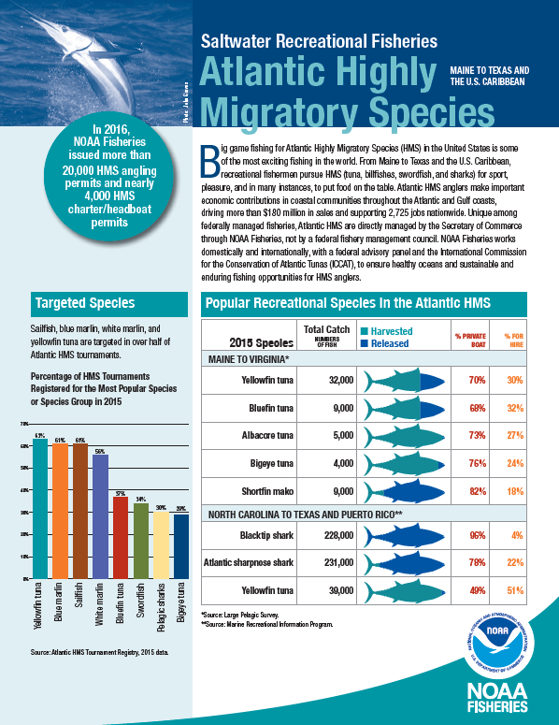








Online Webtool
Fact Sheets and Infographics
Congress
The Public
Saltwater Recreational Fisheries Snap Shots
Notes:
These scripts also output content that gets used in the fact sheets and infographics (part of the report roll out), the report is used by congress to understand the contribution of fisheries to the US economy to the public, for external reports and factsheets such as the Saltwater Recreational Fisheries Snap Shots reports output by NOAA Fisheries Office of Sustainable Fisheries, and to create javascript files that are used directly in our online webtool.

Slide 20


Waiting in the Wings
Continue contemporizing the report
Redevelop other analyses used in the report currently in Excel calculators into R functions and packages
Include additional economic models and analyses produced by the office
Improve report turn around time to better coordinate with release of other reports
Notes:
But the job is not over - There’s A LOT waiting in the wings for future.
This report hasn’t gotten much TLC in the last 10 years. Despite how far it has come, there is still more work that needs to be done to continue contemporizing the contextual and descriptive content of this report.
There are analyses that can be converted from excel to R for faster and more confident runs
There are other analyses that our office is working on and should be included in this report to provide more context on the economic state of fisheries In the US
And overall, more to be done to improve the turn around time of this report so it may better coordinate with the release of other nationally important reports like the fisheries of the US report.

Slide 21


QUESTIONS?
Special thanks to Rita Curtis, Sabrina Lovell, Noelle Olsen, Jacqui Fenner, and other FEUS collaborators.
Emily.Markowitz@noaa.gov
@EmilyHMarkowitz
@EmilyMarkowitz
@EmilyHMarkowitz
Notes:
With that I’ll take any questions, comments, or insight at the end of the session! If you have any questions or want to learn more, feel free to contact me by email or by any of my social media handles.
Thanks!

Slide 22
Find this presentation at: YouTube: https://www.youtube.com/watch?v=-mycRwaC60A PPTX: https://github.com/emilyhmarkowitz/FEUS2017Common/tree/master/Presentations

Slide 23
Supplemental

Slide 24
